Slide 1


Green Pace
Security Policy Presentation
Developer: Vince Taliaferro

Slide 2

OVERVIEW: DEFENSE IN DEPTH
This model is tasked with providing a comprehensive outline of the specific defensive techniques employed in our efforts to uphold a robust framework for secure coding.

Slide 3
THREATS MATRIX
Secure coding standards with levels of vulnerability to measure impact of standards set.
Likely [Threats that are very likely to happen] | Priority [Standard with high relevancy.]
Low priority [Standard with low relevancy.] | Unlikely [Not as likely threats to happen.]

Slide 4
10 PRINCIPLES
Ensure Input Data Validation
Pay Attention to Compiler Warnings
Strategize and Develop Security Policy Architecture
Embrace Simplicity in Design
Prioritize Default Denial
Follow the Principle of Minimal Privilege
Scrutinize Data Before Sending to External Systems
Implement Defense Layers
Employ Robust Quality Assurance Methods
Embrace a Secure Coding Protocol

Slide 5
CODING STANDARDS
Avoid Casting to Enum Values Beyond Their Range
Ensure Valid References, Pointers, and Iterators When Accessing Container Elements
Refrain from Creating std::string from Null Pointers
Avoid Storing Owned Pointer Values in Unrelated Smart Pointers
Properly Release Dynamically Allocated Resources
Utilize Static Assertions to Validate Constant Expressions
Handle All Exceptions Thrown Before main() Execution
Avoid Sequential Input/Output Operations on File Streams Without Positioning Calls
Refrain from Calling Virtual Functions Within Constructors or Destructors
Ensure Value-Returning Functions Return a Value in All Exit Scenarios

Slide 6
ENCRYPTION POLICIES
Data Encryption at Rest: This method ensures that data remains encrypted while stored on disk, thereby preventing unauthorized access to unencrypted data. Even if an attacker gains access to encrypted data on a hard drive, without the encryption keys, they must bypass encryption to read the data.
Data Encryption in Transit: This process involves encrypting data while it's being transmitted. For instance, in certain applications like remote replication, data might be unencrypted while at rest on drive arrays but encrypted during transmission to enhance security.
Data Encryption in Use: When data in use is compromised, it exposes encrypted data at rest and data in transit. For instance, individuals with access to random access memory can scan it to locate encryption keys for data at rest. Once these keys are obtained, they can decrypt encrypted data at rest.

Slide 7
TRIPLE-A POLICIES
Authentication: Authentication verifies the identity of a user seeking access to a system. This typically involves confirming credentials such as username and password. Modern methods may employ additional layers of security like two-step authentication or multi-tier authentication.
Authorization: Authorization determines the level of access granted to a user within the system. This encompasses permissions for actions like reading, creating, deleting, or modifying files in the database. It also governs privileges such as adding or removing files and user accounts.
Accounting: Accounting involves monitoring and recording the activities of users based on their access privileges. This entails tracking which databases are accessed, the actions performed, timestamps of activities, and the identification of users accessing the system.

Slide 8
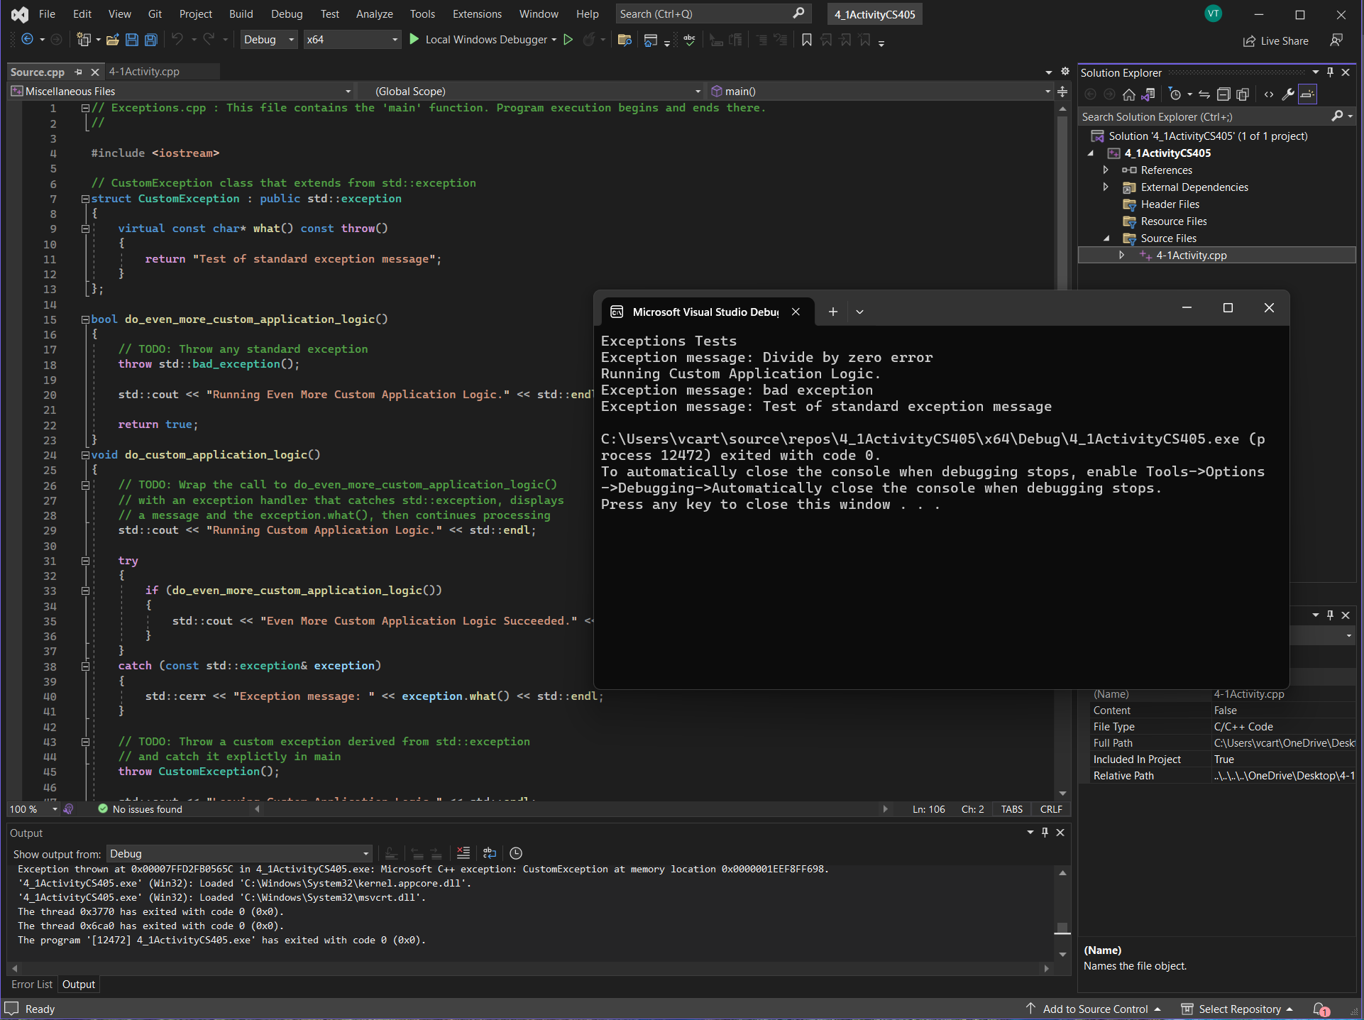
Unit Testing
We integrate unit testing into our development process from the outset to ensure the security and functionality of our code. For instance, we implement measures such as restricting the length of user input strings to prevent buffer overflow vulnerabilities.

Slide 9

AUTOMATION SUMMARY

Slide 10
TOOLS
The DevSecOps pipeline represents a comprehensive secure coding approach, employing a holistic strategy to enforce policies and maintain a secure infrastructure efficiently.
It's essential to maintain a robust system architecture. Additionally, we should continuously prioritize defense in depth and emphasize frequent and early testing to identify and address any potential flaws or vulnerabilities. This proactive approach enables us to detect bugs and errors at an early stage.

Slide 11
RISKS AND BENEFITS
Coding inherently carries risks as achieving 100% security is impossible. It's crucial to adopt a mindset that acknowledges the presence of threats and vulnerabilities within the system. Consistent vigilance and staying updated on contemporary threats and prevention methods are essential for the effectiveness of this policy, emphasizing the critical importance of ongoing education.

Slide 12
RECOMMENDATIONS
Keeping up with all the security threats and trends is a critical piece to maintaining the level of security we promise. We keep everything simple yet effective to get the job done.

Slide 13
CONCLUSIONS
In conclusion, With the principles and standards mentioned within this presentation we can conclude that most of all the important topics were covered to display our plan to create and maintain a secure and proficient programing. We also have adopted a zero-trust policy when it comes to accessing things inside and outside of the company network to maintain security and privacy to keep all sensitive information safe and secure for all parties involved.

Slide 14
REFERENCES

